Slide 2
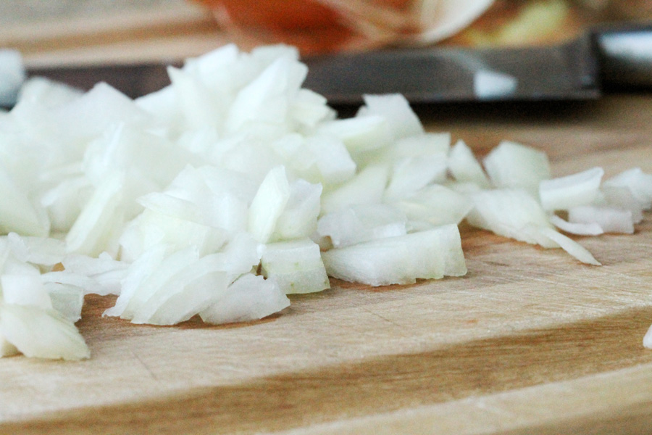
“Cut the Onions!”

Slide 3
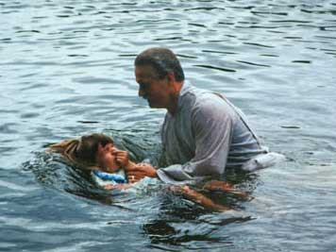

Slide 4
CHURCH

Slide 5
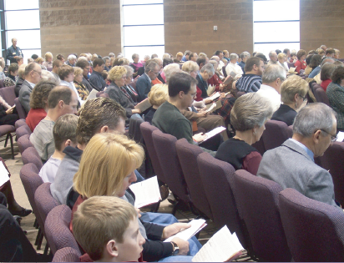
Fellowship

Slide 6
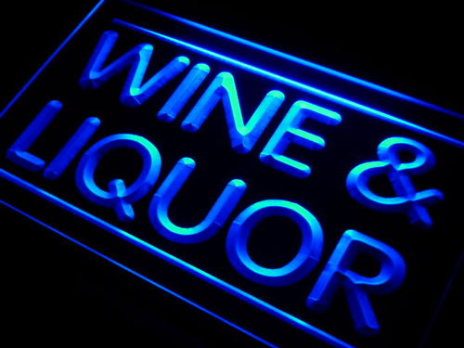
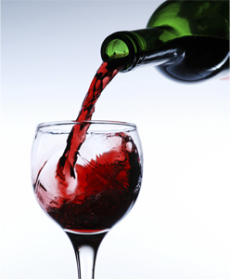
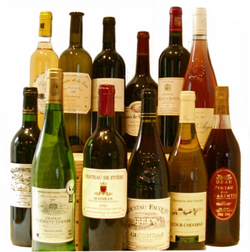
WINE

Slide 7
WINE
Alcoholic
There was alcoholic wine in the Bible.
1. Noah (Gen. 9:20-21).
2. Lot (Gen. 19:32-33).
3. Uriah (2 Sam. 11:13).
4. Descriptions of drunkenness (Psa. 107:27; Job 12:25; Jer. 23:9; Isa. 19:14; Jer. 25:27).

Slide 8
WINE
Alcoholic
Facts about modern wines.
Most modern wines are “fortified” with added yeasts, sugars, or even distilled alcohol.
Distillation was not known in ancient times.
Most yeasts die at 12% alcohol content by volume.
Distilled liquor can attain as much as 95% alcohol content by volume.

Slide 9
WINE
Alcoholic
Wine Coolers | 4–7%
Table Wine general | 8-14%
White, dry | 11.0
White, sparkling | 12.0
White, sweet | 12.4
Cabernet, Pinot Noir | 11–14%
Dessert Wine | 14-20%
Zinfandels | 17-22%
Vermouth | 17-22%
Port Wine | 20%
Taken from : Alcohol Content Database http://www.alcoholcontents.com/wine/

Slide 10
A Different
WINE
There was a different type of drink also called “wine” in the Bible.
1. Juice in the grape is called “wine” (Isa. 65:8; Deut. 32:14; Num. 6:3; Judg. 13:7).
2. Juice fresh from the grape is called “wine” (Gen. 40:11; Josephus Antiquities 2.5.2, gleukos “new wine” Acts 2:13).
3. Juice in the press is called “wine” (Micah 6:15; Prov. 3:10; Isa. 16:10; Jer. 48:33).

Slide 11
A Different
WINE
Is this a figure of speech?
Metonymy of effect
“the effect is put for the cause producing it” (Bullinger, Figures of Speech Used in the Bible, 560-67).
Genesis 25:23
“two nations are in your womb.”
Metonymy depends on a clear distinction.

Slide 12
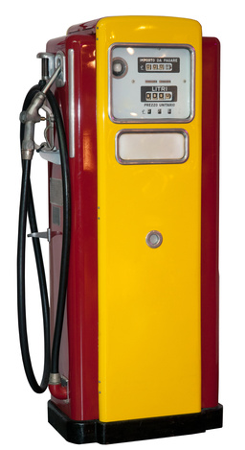
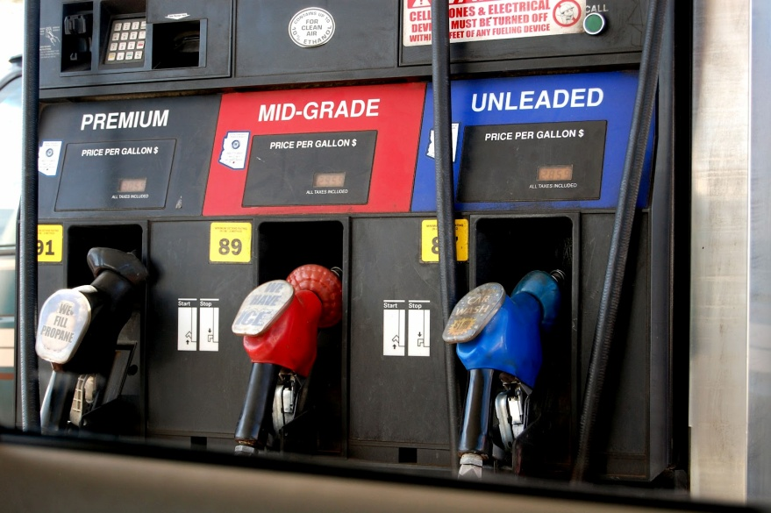
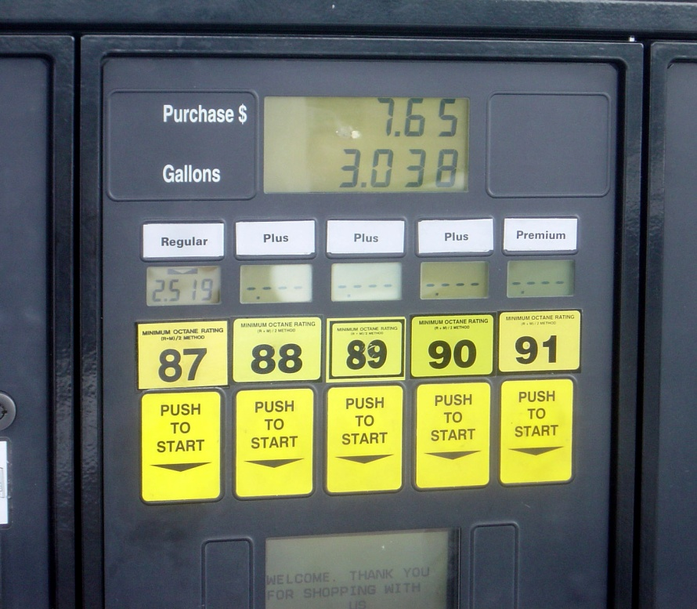
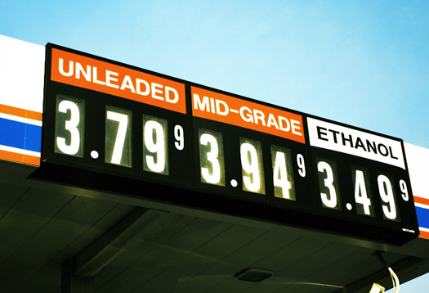
“I’m going to get gas”

Slide 13
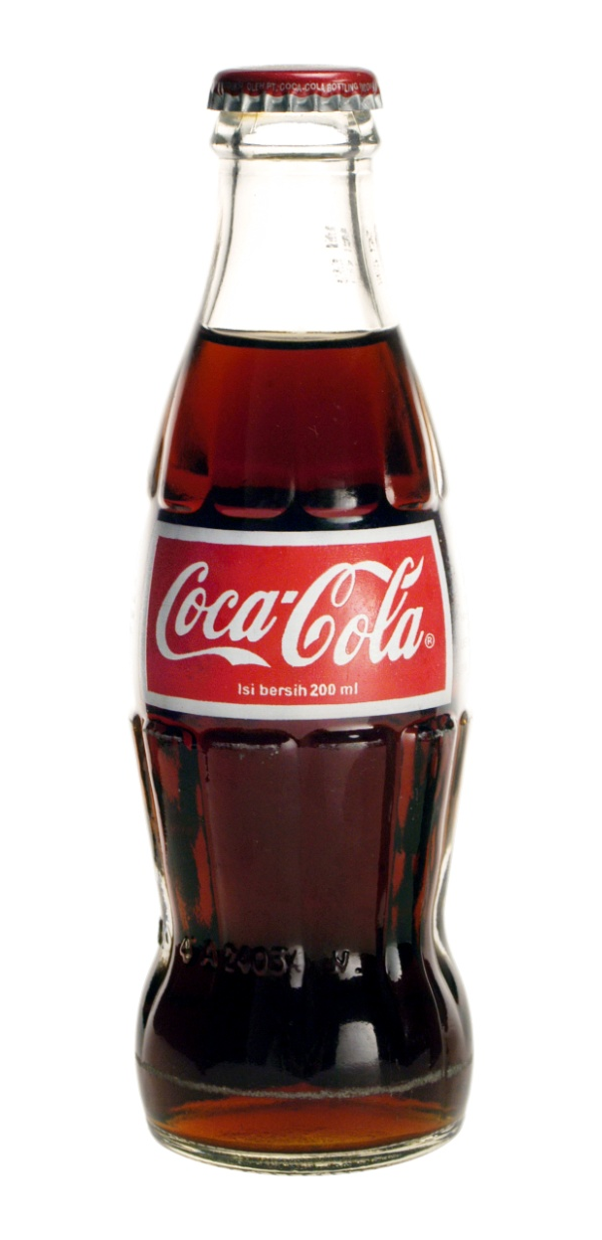
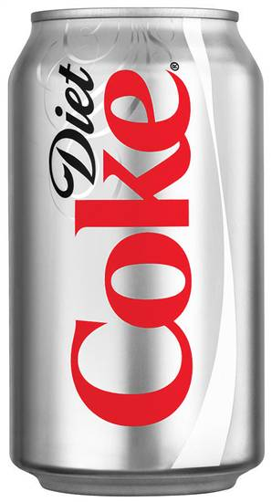
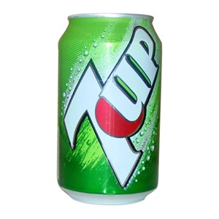
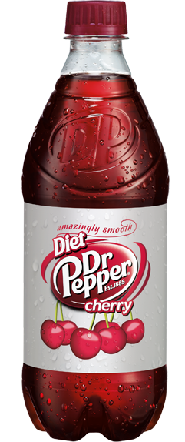
“Get me a coke, please”

Slide 14
WINE
Contrasting
Descriptions of
New Wine (tirosh) “cheers both God and men” (Judges 9:13), but wine (yayin) “is a mocker” (Prov. 20:1).
God speaks of those who drink “the wine of the condemned in the house of their god” (Amos 2:8).

Slide 15
WINE
Contrasting
Descriptions of
New Wine (tirosh) was considered a blessing from God (Deut. 7:13; 11:14; 33:28) and taken away as punishment (Deut. 28:51; Isa. 24:7; 62:8), but man is warned not to “look upon” wine (yayin)—“when it is red, when it giveth his colour in the cup, when it moveth itself aright” (Prov 23:31, KJV).

Slide 16
WINE
Contrasting
Descriptions of
Wine is used as a figure of punishment. Some “eat the bread of wickedness and drink the wine of violence” (Prov. 4:17). The wicked shall “drink the wine of the wrath of God” (Rev. 14:10), and “the wine of the fierceness of His wrath” (Rev. 16:19).

Slide 17
WINE
Contrasting
Descriptions of
Paul tells Timothy to drink “a little wine (oinos) for your stomach’s sake” (1 Tim. 5:23), but the wise man warns “it is not for kings to drink wine” (Prov. 31:4).

Slide 18
WINE
Contrasting
Descriptions of
Daniel, Shadrach, Meshach, and Abed-nego petitioned to be able to drink a different wine than the type of wine the king drank (Dan. 1:5, 8).
This could have been an issue of Mosaic cleanliness, but it could also have concerned the nature of the drink itself.

Slide 19
WINE
Contrasting
Descriptions of
Jesus gave the people 120-180 gallons of “water that was turned to wine” (John 2:1-10), and yet…
He taught that “drunkenness” can weigh down one’s heart causing the word to be choked within (Luke 21:34).
His disciples taught that men must turn away from “drunkenness, revelries” and “drinking parties” (1 Pet. 4:3; cf. Rom. 13:13), and that “drunkenness” and “revelries” prevent one from inheriting the kingdom of heaven (Gal. 5:21).

Slide 20
WINE
Contrasting
Descriptions of
Can this be referring to the exact same substance?
Is this only a matter of degree, or amount?
Is it not rather talking about a substance of a different nature, a different preparation, and a different manner of consumption?

