Slide 1
The Resurrection
October 4, 2011
ECI Conference:
Realized Eschatology
Speaker: Allen Dvorak

Slide 2
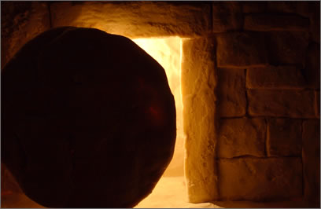
The Resurrection
¹⁴ Remind them of these things, charging them before the Lord not to strive about words to no profit, to the ruin of the hearers. ¹⁵ Be diligent to present yourself approved to God, a worker who does not need to be ashamed, rightly dividing the word of truth. ¹⁶ But shun profane and idle babblings, for they will increase to more ungodliness. ¹⁷ And their message will spread like cancer. Hymenaeus and Philetus are of this sort, ¹⁸ who have strayed concerning the truth, saying that the resurrection is already past; and they overthrow the faith of some.
-- 2 Timothy 2:14-18
¹⁴ Remind them of these things, charging them before the Lord not to strive about words to no profit, to the ruin of the hearers. ¹⁵ Be diligent to present yourself approved to God, a worker who does not need to be ashamed, rightly dividing the word of truth. ¹⁶ But shun profane and idle babblings, for they will increase to more ungodliness. ¹⁷ And their message will spread like cancer. Hymenaeus and Philetus are of this sort, ¹⁸ who have strayed concerning the truth, saying that the resurrection is already past; and they overthrow the faith of some.
-- 2 Timothy 2:14-18

Slide 3
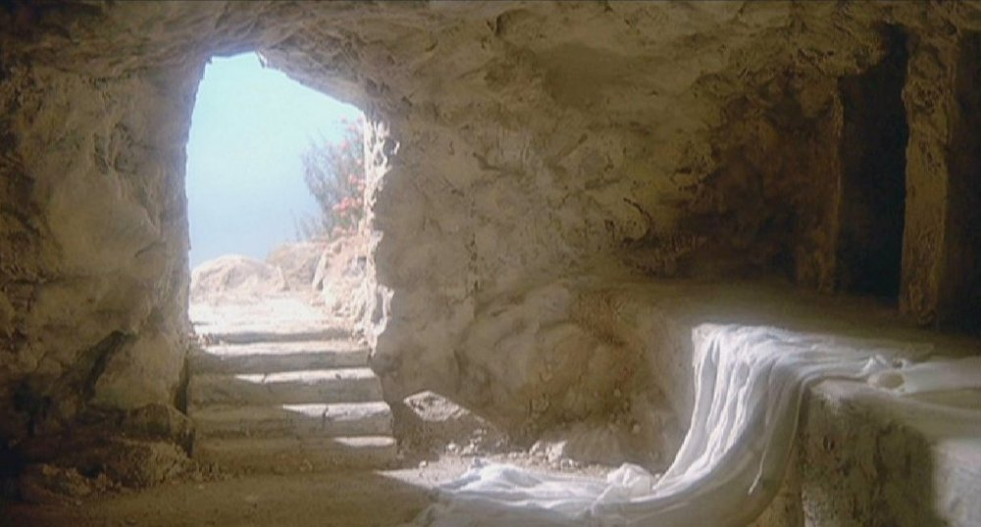
Course of Study
Describe the position of realized eschatologists
Identify and respond to arguments made from 1 Corinthians 15
Briefly survey some other passages that address the resurrection

Slide 4
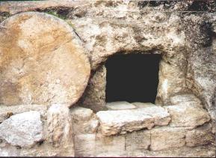
Realized Eschatology View
“There is nothing in Paul’s corporate language of the ‘body’ of Christ that forces us to assume that the resurrection to come (in their day) would involve the literal process of individual corpses coming out of their graves. Instead, the expected eschatological resurrection was the translation of the children of God from the Old Covenant to the New Covenant (2 Cor. 3:18). The death from which we are corporately raised is from sin-death, or alienation from God. This is what it meant for Christ to be the firstfruits of the resurrection (1 Cor. 15:20, 23), the harvest to follow was the early church and all Israel (Jas. 1:18, cf. Rev. 14:4).”
-- King, p. 309
“There is nothing in Paul’s corporate language of the ‘body’ of Christ that forces us to assume that the resurrection to come (in their day) would involve the literal process of individual corpses coming out of their graves. Instead, the expected eschatological resurrection was the translation of the children of God from the Old Covenant to the New Covenant (2 Cor. 3:18). The death from which we are corporately raised is from sin-death, or alienation from God. This is what it meant for Christ to be the firstfruits of the resurrection (1 Cor. 15:20, 23), the harvest to follow was the early church and all Israel (Jas. 1:18, cf. Rev. 14:4).”
-- King, p. 309

Slide 5
Realized Eschatology View
“We established in the previous chapter of this volume that the resurrection Paul spoke of in 1 Corinthians 15 was not a resurrection of physical bodies out of holes in the ground, but the resurrection of Old Covenant Israel from the death of its fellowship with God.”
-- Dawson, p. 109
“We established in the previous chapter of this volume that the resurrection Paul spoke of in 1 Corinthians 15 was not a resurrection of physical bodies out of holes in the ground, but the resurrection of Old Covenant Israel from the death of its fellowship with God.”
-- Dawson, p. 109

Slide 6
Realized Eschatology View
“Who were the ‘some’ at Corinth and whose resurrection were they denying? They certainly didn’t deny their own resurrection. They didn’t deny the resurrection of Christ. They didn’t deny the resurrection of Gentile Christians, whom Paul himself converted from paganism. They didn’t deny the resurrection of Jewish Christians, whom Peter and Paul had converted from Judaism. Who was left to be resurrected after they eliminated the resurrection of dead Gentile Christians and dead Jewish Christians? Only Old Covenant saints, particularly those of Israel. Some at Corinth denied the salvation of the Old Testament faithful. As the chapter 4 of this book demonstrated, the resurrection of the dead ones served as the basis of Paul’s preaching. (cont.)
“Who were the ‘some’ at Corinth and whose resurrection were they denying? They certainly didn’t deny their own resurrection. They didn’t deny the resurrection of Christ. They didn’t deny the resurrection of Gentile Christians, whom Paul himself converted from paganism. They didn’t deny the resurrection of Jewish Christians, whom Peter and Paul had converted from Judaism. Who was left to be resurrected after they eliminated the resurrection of dead Gentile Christians and dead Jewish Christians? Only Old Covenant saints, particularly those of Israel. Some at Corinth denied the salvation of the Old Testament faithful. As the chapter 4 of this book demonstrated, the resurrection of the dead ones served as the basis of Paul’s preaching. (cont.)
“Who were the ‘some’ at Corinth and whose resurrection were they denying? They certainly didn’t deny their own resurrection. They didn’t deny the resurrection of Christ. They didn’t deny the resurrection of Gentile Christians, whom Paul himself converted from paganism. They didn’t deny the resurrection of Jewish Christians, whom Peter and Paul had converted from Judaism. Who was left to be resurrected after they eliminated the resurrection of dead Gentile Christians and dead Jewish Christians? Only Old Covenant saints, particularly those of Israel. Some at Corinth denied the salvation of the Old Testament faithful. As the chapter 4 of this book demonstrated, the resurrection of the dead ones served as the basis of Paul’s preaching. (cont.)

Slide 7
Realized Eschatology View
“It was the identical hope of Israel he preached solely from Moses and the prophets. Yet some Christians denied the resurrection to the very ones it was promised to, the faithful of Israel. The Corinthians most certainly believed in the resurrection of Jewish and Gentile Christians, but not the Old Covenant saints. Paul later affirmed they stood or fell together. Even the resurrection of Christ stood or fell with the resurrection of the Old Testament saints. As an Old Testament saint himself, he was part of that very group! Further, Paul later showed that if the Old Testament saints were not raised (as prophesied in the prophets), then New Testament saints wouldn’t be either. In other words, ‘If the Jews don’t get theirs, you Gentiles won’t get yours!’”
-- Dawson, pp. 139-140
“It was the identical hope of Israel he preached solely from Moses and the prophets. Yet some Christians denied the resurrection to the very ones it was promised to, the faithful of Israel. The Corinthians most certainly believed in the resurrection of Jewish and Gentile Christians, but not the Old Covenant saints. Paul later affirmed they stood or fell together. Even the resurrection of Christ stood or fell with the resurrection of the Old Testament saints. As an Old Testament saint himself, he was part of that very group! Further, Paul later showed that if the Old Testament saints were not raised (as prophesied in the prophets), then New Testament saints wouldn’t be either. In other words, ‘If the Jews don’t get theirs, you Gentiles won’t get yours!’”
-- Dawson, pp. 139-140

Slide 8
Realized Eschatology View
“Paul depicted the ongoing translation of the body of death headed by Adam (which would, of course, contain Old Covenant Israel) to the body of life headed by Christ. This is Paul’s concept of the resurrection, a process ongoing as Paul wrote.”
-- Dawson, p. 144
“Paul depicted the ongoing translation of the body of death headed by Adam (which would, of course, contain Old Covenant Israel) to the body of life headed by Christ. This is Paul’s concept of the resurrection, a process ongoing as Paul wrote.”
-- Dawson, p. 144
“Paul depicted the ongoing translation of the body of death headed by Adam (which would, of course, contain Old Covenant Israel) to the body of life headed by Christ. This is Paul’s concept of the resurrection, a process ongoing as Paul wrote.”
-- Dawson, p. 144

Slide 9
Realized Eschatology View
“Before Jesus’ generation ended, he had conquered everything except Adam’s death. He had even overcome physical death, hadn’t he? Of course, lying, stealing, and murder still exist, but not under Christ’s reign. Those over whom he reigns share no part in those evil deeds. However, at the resurrection Paul spoke of here (the resurrection of Israel from spiritual death, the death Adam died the day he sinned, the death of his fellowship with God), death was conquered and abolished. The resurrection which Moses and the prophets taught, all the apostles preached, and Paul taught in 1 Corinthians 15, is about restoration of fellowship with God, not about being raised from biological death. (cont.)
“Before Jesus’ generation ended, he had conquered everything except Adam’s death. He had even overcome physical death, hadn’t he? Of course, lying, stealing, and murder still exist, but not under Christ’s reign. Those over whom he reigns share no part in those evil deeds. However, at the resurrection Paul spoke of here (the resurrection of Israel from spiritual death, the death Adam died the day he sinned, the death of his fellowship with God), death was conquered and abolished. The resurrection which Moses and the prophets taught, all the apostles preached, and Paul taught in 1 Corinthians 15, is about restoration of fellowship with God, not about being raised from biological death. (cont.)

Slide 10
Realized Eschatology View
“Obviously, though Jesus conquered physical death in his resurrection, physical death was not abolished in Jesus’ generation, nor is it yet. Both wicked and righteous men still die physically. However, Adam’s sin-death, or the death of his fellowship with God, was abolished at the resurrection in Jesus’ generation. If the popular view is correct that Paul spoke of victory over physical death, it’s hard to see how those things have continued for over two thousand years now, and the job still isn’t done!”
-- Dawson, pp. 168-169
“Obviously, though Jesus conquered physical death in his resurrection, physical death was not abolished in Jesus’ generation, nor is it yet. Both wicked and righteous men still die physically. However, Adam’s sin-death, or the death of his fellowship with God, was abolished at the resurrection in Jesus’ generation. If the popular view is correct that Paul spoke of victory over physical death, it’s hard to see how those things have continued for over two thousand years now, and the job still isn’t done!”
-- Dawson, pp. 168-169

Slide 11
Realized Eschatology View
“All men in Adam, including Old Covenant Israel, the ‘dead ones,’ were ‘the natural man,’ as all men in Christ were ‘the spiritual man.’ As Paul wrote, Jews and Gentiles alike were in the body of Adam, because they died spiritually, and their body (singular) that was rising or made alive was the body of Christ, and still is.”
-- Dawson, p. 187
“All men in Adam, including Old Covenant Israel, the ‘dead ones,’ were ‘the natural man,’ as all men in Christ were ‘the spiritual man.’ As Paul wrote, Jews and Gentiles alike were in the body of Adam, because they died spiritually, and their body (singular) that was rising or made alive was the body of Christ, and still is.”
-- Dawson, p. 187

Slide 12
Realized Eschatology View
“Who were the ‘dead ones?’ They were the same Old Covenant dead ones Paul discussed throughout the chapter, the very ones the Gentile Christians in the Paul Party denied the resurrection to.”
-- Dawson, p. 190
“Who were the ‘dead ones?’ They were the same Old Covenant dead ones Paul discussed throughout the chapter, the very ones the Gentile Christians in the Paul Party denied the resurrection to.”
-- Dawson, p. 190
“We’ve already seen that he referred to the old man Adam, and that immortality is not an innate property of man given at birth, but is given at the resurrection. The corruptible body (not bodies) Paul spoke of was fleshly, Old Covenant Israel or the old man Adam. At the resurrection of Israel in Jesus’ generation, that body would be transformed into the incorruptible body, New Covenant Israel.”
-- Dawson, p. 191
“We’ve already seen that he referred to the old man Adam, and that immortality is not an innate property of man given at birth, but is given at the resurrection. The corruptible body (not bodies) Paul spoke of was fleshly, Old Covenant Israel or the old man Adam. At the resurrection of Israel in Jesus’ generation, that body would be transformed into the incorruptible body, New Covenant Israel.”
-- Dawson, p. 191

Slide 13
Realized Eschatology View
“Preterism (sometimes called ‘Full Preterism’) is almost identical to the Reformed partial Preterist position, with only one great exception - the nature of the resurrection. Whereas the Reformed position teaches a bodily resurrection, Preterism agrees with Paul, that ‘it is sown a natural body, it is raised a spiritual body’ (I Cor. 15:44). The spiritual nature of the general resurrection (though Preterists strongly defend Christ's bodily resurrection) is, probably, the main factor that precludes Preterism from being absorbed into any other denominational positions, unlike partial Preterism, which is conformable to nearly all…
-- Todd Dennis
“Preterism (sometimes called ‘Full Preterism’) is almost identical to the Reformed partial Preterist position, with only one great exception - the nature of the resurrection. Whereas the Reformed position teaches a bodily resurrection, Preterism agrees with Paul, that ‘it is sown a natural body, it is raised a spiritual body’ (I Cor. 15:44). The spiritual nature of the general resurrection (though Preterists strongly defend Christ's bodily resurrection) is, probably, the main factor that precludes Preterism from being absorbed into any other denominational positions, unlike partial Preterism, which is conformable to nearly all…
-- Todd Dennis

Slide 14
Realized Eschatology View
The Second Coming of Christ is directly stated as occurring in the space of the men then living (Matt. 10:23; Matt. 16:27, 28; Matt. 24:34), and is also often implied as being very near (James 5:8, 9; 1 Pet. 4:7; I Thess. 5:23, etc.). The Judgment is also declared and implied as being within a short space (Matthew 3:7; 16:27-28; 23:36-38; Acts 2:16, 17, 20; James 5:9; I Peter 4:5, 17; Revelation 22:12), as was the Resurrection, which is nothing more than the redemption of believers from the same death passed upon them by the curse spoken in Genesis 2:17. To prove the nature of the resurrection, Paul states the following: ‘It is sown a natural body, it is raised a spiritual body’ (I Cor. 15:44). This most significant passage is almost entirely overlooked when considering the actual substance or nature of the resurrection body!”
-- Todd Dennis
The Second Coming of Christ is directly stated as occurring in the space of the men then living (Matt. 10:23; Matt. 16:27, 28; Matt. 24:34), and is also often implied as being very near (James 5:8, 9; 1 Pet. 4:7; I Thess. 5:23, etc.). The Judgment is also declared and implied as being within a short space (Matthew 3:7; 16:27-28; 23:36-38; Acts 2:16, 17, 20; James 5:9; I Peter 4:5, 17; Revelation 22:12), as was the Resurrection, which is nothing more than the redemption of believers from the same death passed upon them by the curse spoken in Genesis 2:17. To prove the nature of the resurrection, Paul states the following: ‘It is sown a natural body, it is raised a spiritual body’ (I Cor. 15:44). This most significant passage is almost entirely overlooked when considering the actual substance or nature of the resurrection body!”
-- Todd Dennis

Slide 15
Realized Eschatology View
“The Mosaic regime was hovering over, smothering, dominating, intimidating, and persecuting the Christian system, so that the kingdom, the church, in its power and glory, was not yet fully operative. However, in A.D. 70, when the Jewish nation was destroyed by the Roman, the church, or ‘the body’ was, in a manner of speaking, resurrected. It had, in effect, been ‘buried’ under Judaism for forty years, from A.D. 30 to 70. When the Jewish nation fell in A.D. 70, there was then, effectually, a resurrection of Christianity, a raising of the body of Christ, from that old suppressive Judaistic system. So, according to the theology of Max King and his followers, when the Bible speaks of the resurrection of the body, it is not discussing the human body; rather, it is alluding to the resurrection of the church out of Judaism in A.D. 70.”
-- Jackson, p. 46
“The Mosaic regime was hovering over, smothering, dominating, intimidating, and persecuting the Christian system, so that the kingdom, the church, in its power and glory, was not yet fully operative. However, in A.D. 70, when the Jewish nation was destroyed by the Roman, the church, or ‘the body’ was, in a manner of speaking, resurrected. It had, in effect, been ‘buried’ under Judaism for forty years, from A.D. 30 to 70. When the Jewish nation fell in A.D. 70, there was then, effectually, a resurrection of Christianity, a raising of the body of Christ, from that old suppressive Judaistic system. So, according to the theology of Max King and his followers, when the Bible speaks of the resurrection of the body, it is not discussing the human body; rather, it is alluding to the resurrection of the church out of Judaism in A.D. 70.”
-- Jackson, p. 46

Slide 16
Summary of the View of Realized Eschatologists
The resurrection discussed in the New Testament was a spiritual one, rather than a resurrection of changed physical bodies.
There will be no bodily (physical) resurrection at any time.
The resurrection actually occurred over a period of time, rather than being a “point-action-in-time” event.

Slide 17
Summary of the View of Realized Eschatologists
The identity of the “dead ones” resurrected varies, depending on which proponent of the theory one is reading. Suggestions include:
The church (from the oppression of Judaism)
All of God’s spiritual children, including Old Covenant saints and New Testament converts, both Jewish and Gentile
Dawson believes the discussion of Paul in 1 Corinthians 15 is specifically discussing a “sub-set” of the entire group resurrected, i.e., Old Covenant saints.

Slide 18
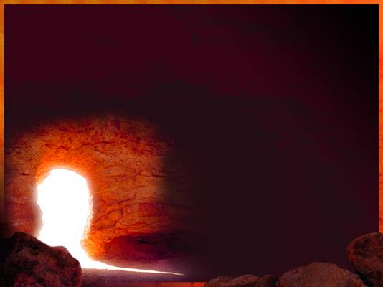
A Summary of
First
Corinthians 15
You already accepted the resurrection of the dead.
The consequences of no resurrection of Christ
What kind of body?

Slide 19
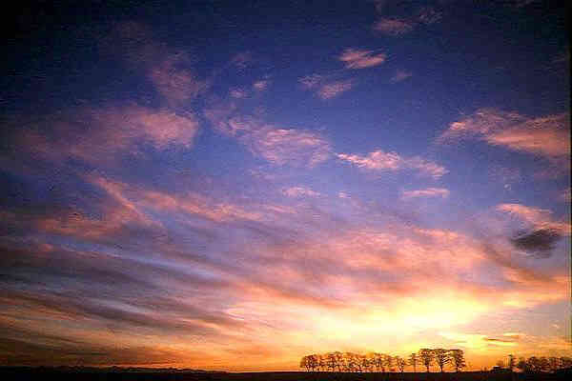
Arguments from First Corinthians 15
The overall context of First Corinthians
The nature of the “death” in chapter 15
The use of the present passive tense
The use of “body” versus “bodies”
The use of quotations from Old Testament prophets

Slide 20
Tension Between Jewish & Gentile Christians?
“Since Paul’s most critical opposition there (Corinth – asd) came from unbelieving Jews, tension naturally arose between Jew and Gentile Christians, which we will see further in I Corinthians, especially including chapter 15.” (Dawson, 118)
“The tension that existed between these two groups contributed to the parties and divisions in the church there, as it did throughout the first-century church where both groups were present.” (Dawson, 119)

Slide 21
Tension Between Jewish & Gentile Christians?
“In Chapter 1, Paul introduced the schisms or parties among the Corinthians. We’ll discuss these parties further in the commentary section, but for now, we’ll say that brethren calling themselves after Paul, Apollos, and Peter (all Jews) were based on the attitudes of superiority that Gentile Christians had toward Jewish Christians.” (Dawson, 122)
“In Chapter 15, Paul detailed the resurrection of the dead and dealt with the denial of it by one of the parties to others outside their party.” (Dawson, 125)

Slide 22
Tension Between Jewish & Gentile Christians?
“In Chapter 2, Paul showed that he was no greater than the other apostles, especially Peter to temper the enthusiasm of Gentiles in the ‘Paul Party,’ the very existence of which Paul abhorred, and whose attitude toward Jewish Christians he deplored. These Gentiles were denying the resurrection to ‘some’ in I Corinthians 15.” (Dawson, 123)
“Thus, most of the chapters of I Corinthians deal with various aspects of the same party divisions that Paul tackled in the first chapter. I Corinthians 15 didn’t just drop out of heaven with no context. Yet the popular view of the chapter completely ignores the context of the Jew-Gentile conflict of who was pleasing to God, as we’ll see.” (Dawson, 125)

Slide 23
The reason for Paul’s Discussion in 1 Cor. 15?
“We may assume these Corinthians knew little of the Old Testament prophets, but on the resurrection, Paul asserted that he taught nothing but Moses and the prophets, and that the Corinthians received, embraced, and stood fast in that teaching. Thus, the issue Paul dealt with in this chapter was not that the Corinthians, any of them, rejected the resurrection. They embraced it.” (Dawson, 129)
“It was only this latter group (Old Covenant saints – asd) that some at Corinth didn’t believe would participate in the resurrection.” (Dawson, 149)

Slide 24
The reason for Paul’s Discussion in 1 Cor. 15?
[Commenting on 1 Corinthians 15:1-11] “Paul did not strive in this section to prove that Jesus was raised from the dead, that there was to be a resurrection of the dead, that the Corinthians denied the resurrection of the dead, nor that some denied the resurrection of dead Christians. His goal was to show that the apostles all preached exactly the same thing on the resurrection. This being true, it wasn’t appropriate for the Corinthians to be divided, which they were, on the resurrection of the dead.” (Dawson, 127)

Slide 25
The reason for Paul’s Discussion in 1 Cor. 15?
Now if Christ is preached that He has been raised from the dead, how do some among you say that there is no resurrection of the dead?
-- 1 Corinthians 15:12
¹ Moreover, brethren, I declare to you the gospel which I preached to you, which also you received and in which you stand, ² by which also you are saved, if you hold fast that word which I preached to you -- unless you believed in vain. ³ For I delivered to you first of all that which I also received: that Christ died for our sins according to the Scriptures, ⁴ and that He was buried, and that He rose again the third day according to the Scriptures, ⁵ and that He was seen by Cephas, then by the twelve. ⁶ After that He was seen by over five hundred brethren at once, of whom the greater part remain to the present, but some have fallen asleep. ⁷ After that He was seen by James, then by all the apostles. ⁸ Then last of all He was seen by me also, as by one born out of due time.

Slide 26
What Is the “death” of 1 C0rinthians 15?
²⁰ But now Christ is risen from the dead, and has become the firstfruits of those who have fallen asleep. ²¹ For since by man came death, by Man also came the resurrection of the dead. ²² For as in Adam all die, even so in Christ all shall be made alive. ²³ But each one in his own order: Christ the firstfruits, afterward those who are Christ's at His coming. ²⁴ Then comes the end, when He delivers the kingdom to God the Father, when He puts an end to all rule and all authority and power. ²⁵ For He must reign till He has put all enemies under His feet. ²⁶ The last enemy that will be destroyed is death.

Slide 27
What Is the “death” of 1 C0rinthians 15?
“People, I’m saying what you already know to be true. The resurrection being denied in 1 Corinthians 15 was a denial of the coming to life again of dead bodies otherwise it could not have affected the bodily resurrection of Jesus. The resurrection of Jesus was being undermined by the consequence of the Corinthian denial (vs. 13, 16). The Corinthians were saying, ‘Dead bodies cannot rise.’ Paul said, ‘If that is true, Jesus couldn’t have risen.’”
-- The McGuiggan-King Debate, p. 235; cited by Almon Williams

Slide 28
“It’s In the Greek!”
“In most of our translations, the present, past, and perfect tenses are translated well. However, in 1 Corinthians 15, the present passive tense has received ill treatment. The present active tense shows how the subject of the sentence is acting. An entirely different concept, the present passive tense shows how the subject of the sentence is being acted upon. Yet his present passive tense is often ignored, or completely changed to a future.” (Dawson, 135)

Slide 29
“It’s In the Greek!”
“1 Corinthians 15 contains many instances of abuse of the present passive tense, where translators ignored, weakened, or changed the tense. Rather than being due to translational difficulties, this indicates translators’ bias. This “rising” was already in progress when Paul wrote these words, which rules out a resurrection of fleshly bodies out of the dirt sometime in our future.” (Dawson, 136-137)

Slide 30
“It’s In the Greek!”
(Commenting on 1 Corinthians 15:26) “Literally, this is ‘the last enemy that is being destroyed.’ Notice the present passive tense, depicting an ongoing process occurring as Paul wrote, was translated as shall be, a future! How ‘misleading’ is that? This is not scholarship, nor is it a translational difficulty. It’s no more difficult than discerning a present tense from a future tense! It is probably theological bias. As we’ll continue to see, this ignoring and changing the tense of the verbs Paul used has profound implications on the subject of the resurrection.” (Dawson, 167-168)

Slide 31
“It’s In the Greek!”
^{NKJ} 1 Corinthians 15:26
“The last enemy that will be destroyed is death.”
^{ESV} 1 Corinthians 15:26
“The last enemy to be destroyed is death.”
^{NAU} 1 Corinthians 15:26
“The last enemy that will be abolished is death.”
^{NIV} 1 Corinthians 15:26
“The last enemy to be destroyed is death.”
^{KJV} 1 Corinthians 15:26
“The last enemy that shall be destroyed is death.”

Slide 32
“It’s In the Greek!”
J. Harold Greenlee lists the futuristic present (the present used for the future) among the uses of the present indicative (53).
Under “Special Uses of the Present,” Dana & Mantey list the futuristic present and comment, “This use of the present tense denotes an event which has not yet occurred, but which is regarded as so certain that in thought it may be contemplated as already coming to pass” (185).

Slide 33
“It’s In the Greek!”
“In a similar way, the Present Indicative may be used to describe vividly a future event (he cites Mark 9:31, Matthew 28:18; 27:63 and Luke 3:9)…The term ‘Present for Future’ is sometimes objected to, but, without good reason. The arguments of Buttmann, pp. 203f., and Winer, WT. pp. 265 ff.; WM. pp. 331 ff., are valid only against the theory of an arbitrary interchange of tenses. It is indeed not to be supposed that Greek writers confused the Present and the Future tenses, or used them indiscriminately. But that the form which customarily denoted an act in progress at the time of speaking was sometimes, for the sake of vividness, used with reference to a fact still in the future, is recognized by all grammarians. See, e.g., J. 397; K. 382, 5; G.MT. 32. The whole force of the idiom is derived from the unusualness of the tense employed.” (Burton’s Moods and Tenses)

Slide 34
“It’s In the Greek!”
Commenting on verse 26, Morris writes, “It (the verb to destroy – asd) is in the present tense, and the use of this tense for future action strikes a note of vividness and certainty” (216).

Slide 35
How Many Bodies?
But someone will say, "How are the dead raised up? And with what body do they come?“
-- 1 Corinthians 15:35
“Second, we often read, ‘And with what kind of body do they come?’ and wonder: Will they have broken bodies, aborted bodies, drowned bodies, mangled bodies, baby bodies, or wrinkled bodies? Since circumcision was such an important issue in the New Testament, will they be circumcised or uncircumcised bodies? Will they be male and female bodies? Will some be the bodies of amputees? Do you notice the shift we make from ‘body’ to ‘bodies’? Paul said ‘body,’ and we think ‘bodies.’ (cont.)

Slide 36
How Many Bodies?
Paul never used ‘bodies’ in this chapter. He spoke of the resurrection of one body, the Old Covenant faithful who were being transformed into the body of Christ. The question had to do with how Jewish and Gentile saints were going to be in that one body, along with Old Covenant saints who didn’t even see or obey Christ. Paul had already said that those who deny the resurrection of the Old Testament dead ones must also deny the resurrection of Christ. Christ died for them because of promises made to the fathers, yet some in the Paul Party denied the resurrection of those for whom Christ died according to promise.” (Dawson, 177-178)

Slide 37
How Many Bodies?
“Finally, a misuse of English grammar is the smug insistence that when a word is singular in form, it must be singular in usage. For instance, Max King does this repeatedly in resurrection passages where the term body is often in the singular number although it obviously has a plural force…Nigel Turner, a Greek scholar, puts the clincher on this usage in the Bible when he explains the reason for its prevalence, ‘Contrary to normal Greek and Latin practice, the N.T. sometimes follows the Aram. and Hebrew preference for a distributive singular’ (Moulton 23) and gives numerous examples in his grammar on page 23.” (Almon Williams, 228)

Slide 38
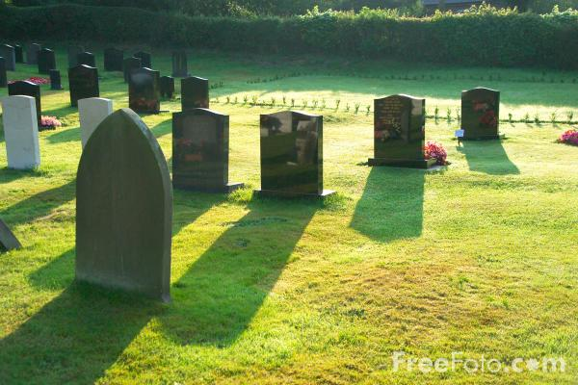
OT Citations in 1 Corinthians 15
“He will swallow up death forever, and the Lord God will wipe away tears from all faces; the rebuke of His people He will take away from all the earth; for the Lord has spoken.”
-- Isaiah 25:8
“So when this corruptible has put on incorruption, and this mortal has put on immortality, then shall be brought to pass the saying that is written: ‘Death is swallowed up in victory.’”
-- 1 Corinthians 15:54

Slide 39
OT Citations in 1 Corinthians 15
“I will ransom them from the power of the grave; I will redeem them from death. O Death, I will be your plagues! O Grave, I will be your destruction! Pity is hidden from My eyes.”
-- Hosea 13:14
“O Death, where is your sting? O Hades, where is your victory?”
-- 1 Corinthians 15:55

Slide 40
OT Citations in 1 Corinthians 15
According to realized eschatology…
The original contexts of these citations – not about resurrection from physical death
Paul’s use of the citations – indicate that 1 Cor. 15 is about a spiritual resurrection
The original contexts of the quotations determine the context of 1 Corinthians 15

Slide 41
OT Citations in 1 Corinthians 15
“The Old Testament foretold the resurrection quite a number of times, not the popular view of fleshly bodies coming out of holes in the ground, but a lot about the resurrection of Israel: how Israel would die, be planted like a seed, be resurrected and transformed, etc. This is why Paul could quote his conclusion in 1 Corinthians 15 from Isaiah 25 and Hosea 13, which we’ll soon see, were to be imminently fulfilled when Jerusalem and the temple were destroyed.”
-- Dawson, p. 105-106

Slide 42
OT Citations in 1 Corinthians 15
“No serious student of the prophets believes a physical resurrection of a physical body is depicted in Isaiah 25. Yet, ignoring the significance of Paul’s quotation of this verse in I Corinthians 15, we think it’s a physical resurrection out of the dirt, although we can’t read that interpretation back into Isaiah. If we do, remember Paul asserted that he didn’t preach anything except what Moses and the prophets taught on the subject; but popularly, we make him do the very thing he denied.”
-- Dawson, p. 192

Slide 43
OT Citations in 1 Corinthians 15
According to realized eschatology…
The original contexts of these citations are about a spiritual resurrection.
Paul had to use these OT citations in the same context as their original context.
Therefore, Paul was writing about a spiritual resurrection in 1 Corinthians 15.

Slide 44
OT Citations in 1 Corinthians 15
According to realized eschatology…
The original contexts of these citations are about a spiritual resurrection.
Both premises are suspect!
Paul had to use these OT citations in the same context as their original context.
If either premise is untrue, the conclusion doesn’t necessarily follow.
Therefore, Paul was writing about a spiritual resurrection in 1 Corinthians 15.

Slide 45
Conclusions/ 1 Cor. 15
Dawson “invents” both a greater and an immediate context for First Corinthians that don’t exist.
The “firstfruits” are of the same nature as the rest of the harvest.
1 Corinthians 15 is concerned with Jesus’ bodily resurrection.
Dawson’s arguments on Greek verb tense and the distributive use of a word are just quibbles and are easily answered.

Slide 46
John 5:24-29
²⁴ ”Most assuredly, I say to you, he who hears My word and believes in Him who sent Me has everlasting life, and shall not come into judgment, but has passed from death into life. ²⁵ "Most assuredly, I say to you, the hour is coming, and now is, when the dead will hear the voice of the Son of God; and those who hear will live.
²⁶ "For as the Father has life in Himself, so He has granted the Son to have life in Himself, ²⁷ "and has given Him authority to execute judgment also, because He is the Son of Man.
²⁸ "Do not marvel at this; for the hour is coming in which all who are in the graves will hear His voice ²⁹ "and come forth -- those who have done good, to the resurrection of life, and those who have done evil, to the resurrection of condemnation.
Spiritual resurrection
Already happening
“The dead”
One outcome
Physical resurrection
Future
“all who are in the graves”
Two outcomes

Slide 47
1 Thessalonians 4:13-18
¹³ But I do not want you to be ignorant, brethren, concerning those who have fallen asleep, lest you sorrow as others who have no hope. ¹⁴ For if we believe that Jesus died and rose again, even so God will bring with Him those who sleep in Jesus. ¹⁵ For this we say to you by the word of the Lord, that we who are alive and remain until the coming of the Lord will by no means precede those who are asleep. ¹⁶ For the Lord Himself will descend from heaven with a shout, with the voice of an archangel, and with the trumpet of God. And the dead in Christ will rise first. ¹⁷ Then we who are alive and remain shall be caught up together with them in the clouds to meet the Lord in the air. And thus we shall always be with the Lord. ¹⁸ Therefore comfort one another with these words.

Slide 48
Relevant Points
How could these individuals be “in Jesus” prior to the resurrection?
If they had already been resurrected, what is the subsequent resurrection of verse 16?
Paul distinguished between the “dead in Christ” and “we who are alive and remain.”
Did Paul live to see the coming of the Lord, i.e., destruction of Jerusalem?

Slide 49
Mark 12:18-27
¹⁸ Then some Sadducees, who say there is no resurrection, came to Him; and they asked Him, saying:…
²³ “Therefore, in the resurrection, when they rise, whose wife will she be? For all seven had her as wife.” ²⁴ Jesus answered and said to them, "Are you not therefore mistaken, because you do not know the Scriptures nor the power of God? ²⁵ "For when they rise from the dead, they neither marry nor are given in marriage, but are like angels in heaven. ²⁶ "But concerning the dead, that they rise, have you not read in the book of Moses, in the burning bush passage, how God spoke to him, saying, 'I am the God of Abraham, the God of Isaac, and the God of Jacob'? ²⁷ "He is not the God of the dead, but the God of the living. You are therefore greatly mistaken."

Slide 50
Relevant Points
“some Sadducees, who say there is no resurrection…”
If the Sadducees didn’t believe in a spiritual resurrection, why did they ask about levirate marriage, a question which has to do with physical death?
If the Sadducees’ question was about a physical resurrection, why didn’t Jesus correct their misapprehension rather than comment on the absence of marriage after the “spiritual” resurrection?

Slide 51
Mark 12:18-27
“The statement that those in the world to come would neither marry nor be given in marriage is not, as it would appear on the surface, a denial of marriage or physical life in the New Covenant age. Rather, it has the meaning of Paul’s statement that the kingdom of God is not meat and drink, but righteousness, and peace, and joy in the Holy Spirit (Rom. 14:17). Jesus was not teaching that the citizens of the world to come “do not marry” anymore than Paul taught that citizens of the kingdom do not eat or drink. The point being debated is the nature of the world that was to come.”
-- King, p. 368

Slide 52
Mark 12:18-27
“The ‘children of this world’ (the Old Covenant world) were constituted as such by physical birth, being the fleshly seed of Abraham, and a physical sign, circumcision. The citizens of ‘this world’ were propagated by marriage or fleshly procreation. But such would not be true in the world to come (the Christian age). Jesus said those who would be worthy to obtain that world and the resurrection from the dead, would not do so by physical means or methods. It was not the kind of world that could be entered by flesh and blood (1 Cor. 15:50). It was a spiritual world and a heavenly inheritance, involving one’s spiritual relationship with God through Christ. ‘Nor can they die any more’ because they are ‘sons of the resurrection’ (Luke 20:36), refers to the spiritual state of redeemed humanity, and not the physical state. Jesus said those who kept his sayings would never die (Jn. 8:51), ‘And whoever lives and believes in Me shall never die’ (Jn. 11:26). This is because they are the ‘sons of the resurrection’ (Lk. 20:36), which corresponds to the adoption of Romans 8:23.”
--King, p. 368

Slide 53
Mark 12:18-27
²³ “Therefore, in the resurrection, when they rise, whose wife will she be? For all seven had her as wife.” ²⁴ Jesus answered and said to them, "Are you not therefore mistaken, because you do not know the Scriptures nor the power of God? ²⁵ "For when they rise from the dead, they neither marry nor are given in marriage, but are like angels in heaven. ²⁶ "But concerning the dead, that they rise, have you not read in the book of Moses, in the burning bush passage, how God spoke to him, saying, 'I am the God of Abraham, the God of Isaac, and the God of Jacob'? ²⁷ "He is not the God of the dead, but the God of the living. You are therefore greatly mistaken."

Slide 54
Acts 24:14-15, 21
¹⁴ "But this I confess to you, that according to the Way which they call a sect, so I worship the God of my fathers, believing all things which are written in the Law and in the Prophets. ¹⁵ "I have hope in God, which they themselves also accept, that there will be a resurrection of the dead, both of the just and the unjust.
²¹ "unless it is for this one statement which I cried out, standing among them, 'Concerning the resurrection of the dead I am being judged by you this day.' "

Slide 55
Relevant Points
Who are the just? The unjust?
“the expected eschatological resurrection was the translation of the children of God from the Old Covenant to the New Covenant (2 Cor. 3:18). The death from which we are corporately raised is from sin-death, or alienation from God” (King, 309).
Dawson comments on Acts 24:15 –
“Paul here alludes to the prophet Daniel. He believed what the prophet wrote about the resurrection of the just and the unjust (Daniel 12:2), and he believed it to be imminent.” (468)

Slide 56
Daniel 12:1-3
¹ “At that time Michael shall stand up, The great prince who stands watch over the sons of your people; And there shall be a time of trouble, Such as never was since there was a nation, Even to that time. And at that time your people shall be delivered, Every one who is found written in the book. ² And many of those who sleep in the dust of the earth shall awake, Some to everlasting life, Some to shame and everlasting contempt. ³ Those who are wise shall shine Like the brightness of the firmament, And those who turn many to righteousness Like the stars forever and ever.”

Slide 57
Daniel 12:1-3
“But there is more in Daniel 12 – we find that the time of the judgment at the ‘end of the age’ was also to be the time of the resurrection! In fact, the very verse from Daniel (12:3) that Jesus quoted in the Parable of the Wheat and Tares (Mt. 13:43) is a description of some of those who would be raised….Clearly, ‘those who are wise that shine’ are those who slept ‘in the dust of the earth’ and would awake to ‘everlasting life.’ These are the same ones in the parable who are symbolized by the wheat that would be harvested at ‘the end of the age’ and gathered into barns. Those who would awake from ‘the dust of the earth’ to ‘everlasting contempt’ would be the tares that would be burned at the ‘end of the age.’ Here resurrection is inextricably linked to judgment. They were to be raised so that they could be judged.”
-- Dawson, p. 467
“…the resurrection which Moses and the prophets taught, all the apostles preached, and Paul taught in 1 Corinthians 15, is about restoration of fellowship with God, not about being raised from biological death.”
-- Dawson, p. 168

Slide 58
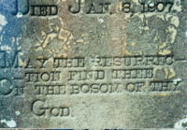
Conclusions
Realized eschatologists “fit” every passage to the theory already adopted.
Words are redefined
Passages are ignored
We have a glorious hope!

Slide 59
Conclusions
“The weakness of our present body is most vividly demonstrated when it perishes, but our resurrected body will be raised ‘in power’ to live without death. It should be noted that Paul does not say we will be raised a spirit, but, rather we will be raised with ‘a spiritual body’ (vs. 44). Throughout this chapter he has emphasized the fact that it is our body that will be raised. It will be raised a spiritual body, and we shall be all that God intends us to be. To illustrate, suppose you had never seen a train, but one day you happened upon a train that had derailed and was a twisted wreck. Have you seen a train? No, you have seen a train wreck, but you have not seen a train as it is intended to be. There is a sense in which we have not seen man as God intends him to be. But one day we shall be perfectly what God intends.” (David Owen, 1996 F.C. Lectures, 216)

Slide 61
John 11:21-26
²¹ Then Martha said to Jesus, "Lord, if You had been here, my brother would not have died. ²² "But even now I know that whatever You ask of God, God will give You.“
²³ Jesus said to her, "Your brother will rise again." ²⁴ Martha said to Him, "I know that he will rise again in the resurrection at the last day."
²⁵ Jesus said to her, "I am the resurrection and the life. He who believes in Me, though he may die, he shall live. ²⁶ "And whoever lives and believes in Me shall never die. Do you believe this?"

Slide 62
Relevant Points
Jesus (vs. 23)
“Your brother will rise again.”
Martha (vs. 24)
“I know that he will rise again in the resurrection at the last day.”
Was she speaking of a spiritual resurrection?
No need for Lazarus to resurrected spiritually
Clearly she expected a physical resurrection!
²⁵ Jesus said to her, "I am the resurrection and the life. He who believes in Me, though he may die, he shall live. ²⁶ "And whoever lives and believes in Me shall never die. Do you believe this?"

Slide 63
Acts 23:1-9
⁶ But when Paul perceived that one part were Sadducees and the other Pharisees, he cried out in the council, "Men and brethren, I am a Pharisee, the son of a Pharisee; concerning the hope and resurrection of the dead I am being judged!" ⁷ And when he had said this, a dissension arose between the Pharisees and the Sadducees; and the assembly was divided. ⁸ For Sadducees say that there is no resurrection -- and no angel or spirit; but the Pharisees confess both. ⁹ Then there arose a loud outcry. And the scribes of the Pharisees' party arose and protested, saying, "We find no evil in this man; but if a spirit or an angel has spoken to him, let us not fight against God."
Since the Sadducees denied a physical resurrection, why would Paul’s comment divide the assembly, if his hope was a spiritual resurrection?

Slide 64
Acts 26:6-8, 21-23
⁶ "And now I stand and am judged for the hope of the promise made by God to our fathers. ⁷ "To this promise our twelve tribes, earnestly serving God night and day, hope to attain. For this hope's sake, King Agrippa, I am accused by the Jews. ⁸ "Why should it be thought incredible by you that God raises the dead?
²¹ "For these reasons the Jews seized me in the temple and tried to kill me. ²² "Therefore, having obtained help from God, to this day I stand, witnessing both to small and great, saying no other things than those which the prophets and Moses said would come -- ²³ "that the Christ would suffer, that He would be the first to rise from the dead, and would proclaim light to the Jewish people and to the Gentiles."

Slide 65
Acts 26:21-23
²¹ "For these reasons the Jews seized me in the temple and tried to kill me. ²² "Therefore, having obtained help from God, to this day I stand, witnessing both to small and great, saying no other things than those which the prophets and Moses said would come -- ²³ "that the Christ would suffer, that He would be the first to rise from the dead, and would proclaim light to the Jewish people and to the Gentiles."
Dawson claims that Paul “said a number of times (in Acts – asd) that on the resurrection, he didn’t preach anything except what Moses and the prophets said should come to pass.” (110)
“We’ll see momentarily that Paul told the Jews on the resurrection that he taught nothing but what Moses and the prophets said would come to pass. Nothing. How could he have said that if he was giving newer revelation on the resurrection than was contained in their Old Testament scriptures?” (103)

Slide 66
Acts 26:23
²³ "that the Christ would suffer, that He would be the first to rise from the dead, and would proclaim light to the Jewish people and to the Gentiles."
^{ASV} how that the Christ must suffer, and how that he first by the resurrection of the dead should proclaim light both to the people and to the Gentiles.
^{NKJ} "that the Christ would suffer, that He would be the first to rise from the dead, and would proclaim light to the Jewish people and to the Gentiles.“
^{ESV} that the Christ must suffer and that, by being the first to rise from the dead, he would proclaim light both to our people and to the Gentiles."

Slide 67
2 Thessalonians 2:1-3
¹ Now, brethren, concerning the coming of our Lord Jesus Christ and our gathering together to Him, we ask you, ² not to be soon shaken in mind or troubled, either by spirit or by word or by letter, as if from us, as though the day of Christ had come. ³ Let no one deceive you by any means; for that Day will not come unless the falling away comes first, and the man of sin is revealed, the son of perdition,
If the coming of the Lord under consideration (realized eschatologists only recognize one “coming” after the earthly ministry of Jesus) was to take place at the destruction of Jerusalem, why didn’t Paul simply say, “You will know when the Lord comes…Jerusalem will be destroyed” – instead of all that cryptic material about the “man of sin”??

Slide 68
2 Corinthians 4:7-5:10
^{4:11} For we who live are always delivered to death for Jesus' sake, that the life of Jesus also may be manifested in our mortal flesh.
^{4:16} Therefore we do not lose heart. Even though our outward man is perishing, yet the inward man is being renewed day by day.
^{5:1} For we know that if our earthly house, this tent, is destroyed, we have a building from God, a house not made with hands, eternal in the heavens. ² For in this we groan, earnestly desiring to be clothed with our habitation which is from heaven, ³ if indeed, having been clothed, we shall not be found naked. ⁴ For we who are in this tent groan, being burdened, not because we want to be unclothed, but further clothed, that mortality may be swallowed up by life.

Slide 69
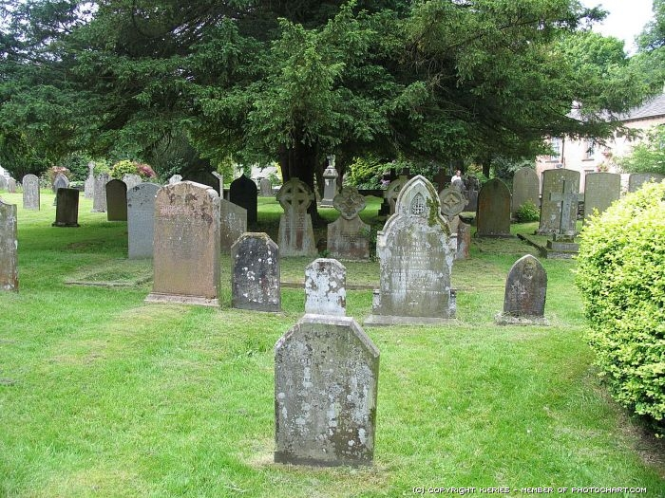
OT Quotations in the NT
Context
Mourning for the people who had been carried off into captivity
Thus says the LORD: “A voice was heard in Ramah, Lamentation and bitter weeping, Rachel weeping for her children, Refusing to be comforted for her children, Because they are no more.”
-- Jeremiah 31:15
Mourning for the infants killed by Herod at the birth of Jesus
Then was fulfilled what was spoken by Jeremiah the prophet, saying: “A voice was heard in Ramah, Lamentation, weeping, and great mourning, Rachel weeping for her children, Refusing to be comforted, Because they are no more.”
-- Matthew 2:17-18

Slide 70
OT Quotations in the NT
Context
Yet the number of the children of Israel Shall be as the sand of the sea, Which cannot be measured or numbered. And it shall come to pass In the place where it was said to them, 'You are not My people,' There it shall be said to them, 'You are sons of the living God.'
-- Hosea 1:10
Then I will sow her for Myself in the earth, And I will have mercy on her who had not obtained mercy; Then I will say to those who were not My people, 'You are My people!' And they shall say, 'You are my God!'
-- Hosea 2:23
The restoration of the Israelites

Slide 71
OT Quotations in the NT
Context
²² What if God, wanting to show His wrath and to make His power known, endured with much longsuffering the vessels of wrath prepared for destruction, ²³ and that He might make known the riches of His glory on the vessels of mercy, which He had prepared beforehand for glory, ²⁴ even us whom He called, not of the Jews only, but also of the Gentiles? ²⁵ As He says also in Hosea: “I will call them My people, who were not My people, And her beloved, who was not beloved.” ²⁶ “And it shall come to pass in the place where it was said to them, 'You are not My people,' There they shall be called sons of the living God.”
-- Romans 9:22-26
The inclusion of the Gentiles

Slide 72
OT Quotations in the NT
Context
A sign to king Ahaz
“Therefore the Lord Himself will give you a sign: Behold, the virgin shall conceive and bear a Son, and shall call His name Immanuel.”
-- Isaiah 7:14
The virgin birth of Christ
²² So all this was done that it might be fulfilled which was spoken by the Lord through the prophet, saying: ²³ “Behold, the virgin shall be with child, and bear a Son, and they shall call His name Immanuel,” which is translated, “God with us.”
-- Matthew 1:22-23

Slide 73
What Is the “death” of 1 C0rinthians 15?
“First, Adam didn’t die physically because of sin. The physical death of Adam and his descendants was not a punishment for Adam’s sin, any more than the physical death of any other living creature was punishment for Adam’s sin. Like all others of Adam’s descendants, you and I will die physically, but not because of Adam’s sin. Our physical death is not a curse for sin. Surely, the serpent was cursed, as was the ground. Likewise, painful childbirth and toilsome labor resulted from Adam’s sin, but we die physically for the same reason Adam did. We’re mortal, as was he, and we lack of (sic) access to the tree of life, as did he.” (Dawson, 155)

Slide 74
What Is the “death” of 1 C0rinthians 15?
²⁰ But now Christ is risen from the dead, and has become the firstfruits of those who have fallen asleep. ²¹ For since by man came death, by Man also came the resurrection of the dead. ²² For as in Adam all die, even so in Christ all shall be made alive. ²³ But each one in his own order: Christ the firstfruits, afterward those who are Christ's at His coming. ²⁴ Then comes the end, when He delivers the kingdom to God the Father, when He puts an end to all rule and all authority and power. ²⁵ For He must reign till He has put all enemies under His feet. ²⁶ The last enemy that will be destroyed is death.

Slide 75
Bodily Resurrection & Hope?
“The resurrection of the body to a pure, holy, and eternal existence is the foundation for hope in the Christian. Everything else is built on it. Being ‘begotten again unto a lively hope, by the resurrection of Jesus Christ from the dead’ (1 Pet. 1:3) is better understood with the addition of ‘to an inheritance incorruptible and undefiled, and that fadeth not away.’ The resurrection secures for the Christian not only a present route or access to the Father but also the guarantee of a new body, not one affected by the deterioration of sin or the ravages of age, one in which he can offer praise and devotion to God forever (John 14:6; Rom. 5:1-5)… (cont.)

Slide 76
Bodily Resurrection & Hope?
There are three things which transform our hope into reality, all of them taking place at the second coming of our Lord. First, in order for man to enjoy the paradise of heaven, he must have an appropriate body, one not subject to the ravages of time. He has, all of his time on the earth, longed desperately for it. Second, there must be a proper habitation for this body, one that will provide a complementary setting for the new body. The habitation must fit the new body in the same way that God made earth the habitation for the body of the first man, Adam. And, finally, he needs eternal existence, a way to protect, preserve, and use his body to the glory of God.”
-- Bowman, p. 186

Slide 77
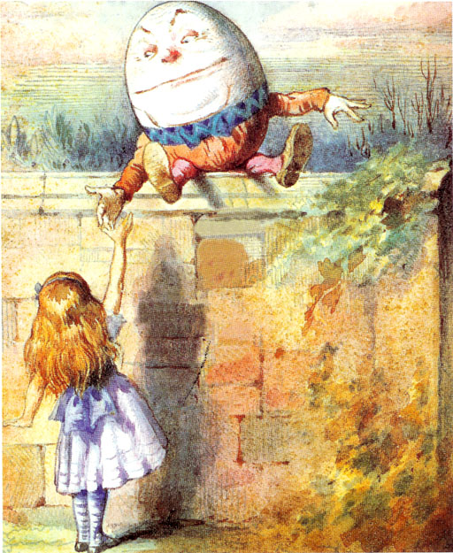
“When I use a word, it means just what I choose it to mean – neither more nor less.”
-- Humpty Dumpty

